Slide 1
Applied Machine learning
Regent College London
SWE6302

Slide 2
Applied Machine learning
SWE6302

Slide 3

Applied Machine learning
Generative AI (Gen AI)

Slide 4
Learning objectives
Understand the fundamentals of Generative AI
Learn about Encoder-Decoder architecture
Learn about Transformers
Learn about Large Language Models (LLMs)
Develop and train your own LLMs
Learn about the ethical concerns around GenAI
Learn about shortcomings of LLMs

Slide 5
GenAI introduction
Generative AI (GenAI) is a type of artificial intelligence that creates new, original content—including text, images, code, audio, and video—by learning patterns from massive datasets using deep learning models.
Unlike traditional AI, which analyzes or classifies existing data, generative AI mimics human creativity to generate novel outputs in response to user prompts. Key examples include Large Language Models (LLMs) like GPT.
Notes:
Pycomates

Slide 6
AI so far…
AI
ML
DL

Slide 7
Generative AI and LLMs
Generative AI is a subset of Deep Learning.
Meaning, it uses Artificial Neural Networks.
Can process labeled or unlabeled data using supervised, unsupervised and semi-supervised methods.
Large language models (LLMs) are also a subset of Deep Learning.

Slide 8
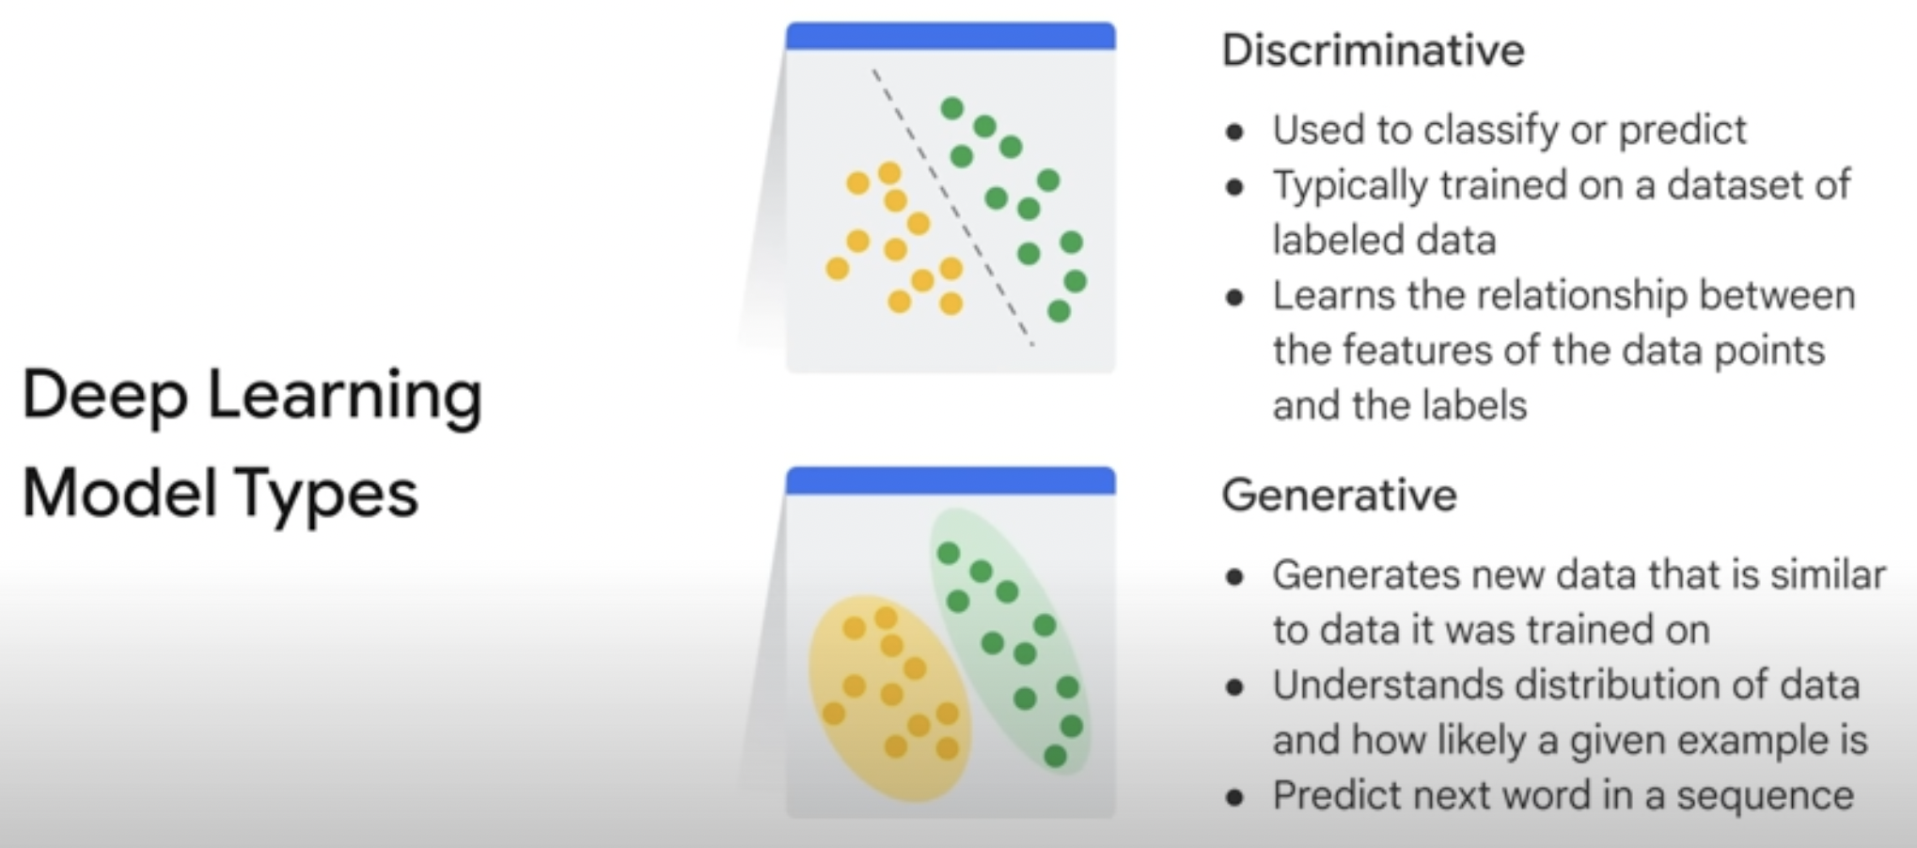
Types of DL models

Slide 9
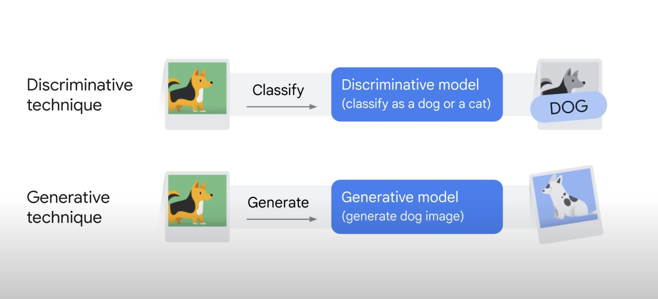
Discriminative vs Generative Technique

Slide 10
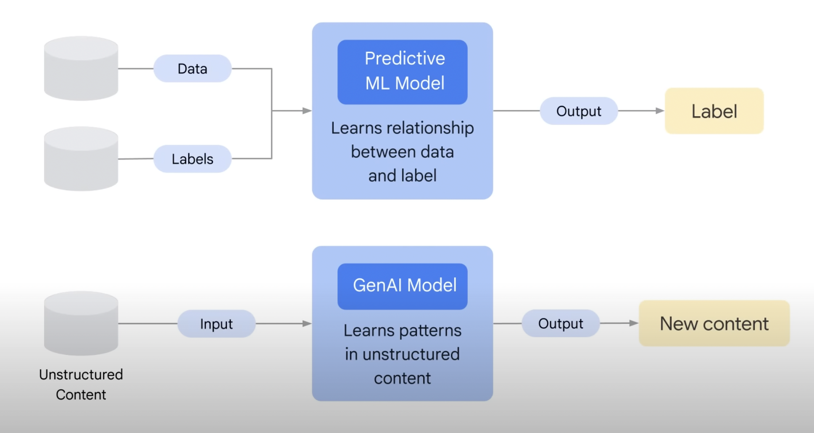
Predictive vs Generative model

Slide 11
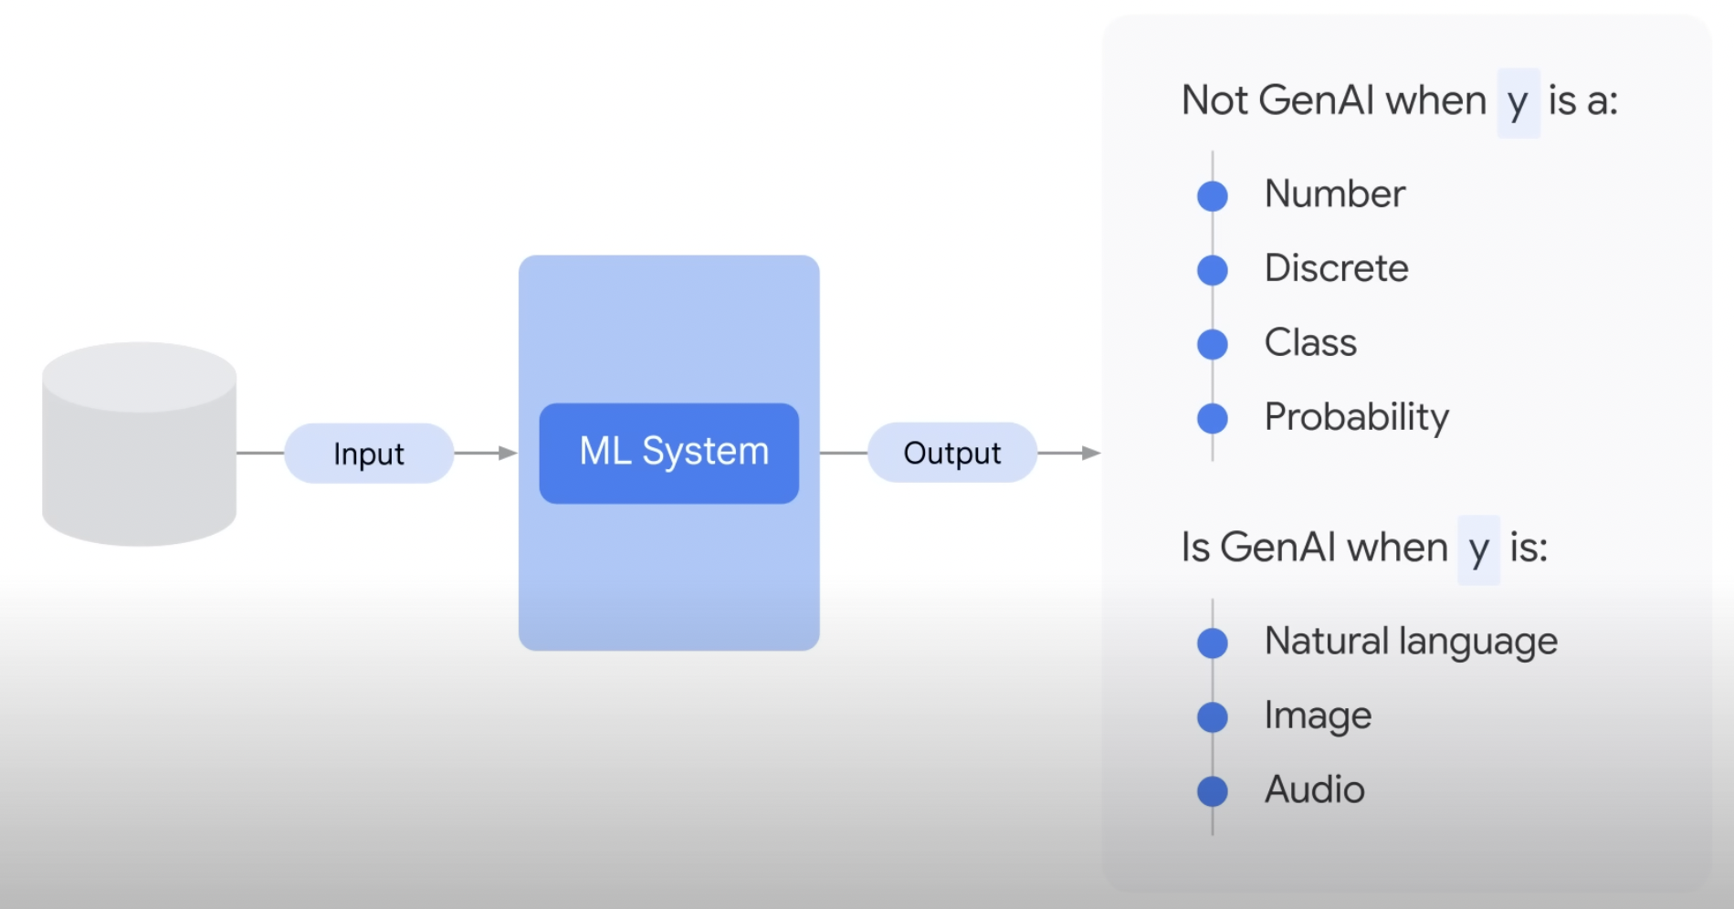
What is not a GenAI?

Slide 12
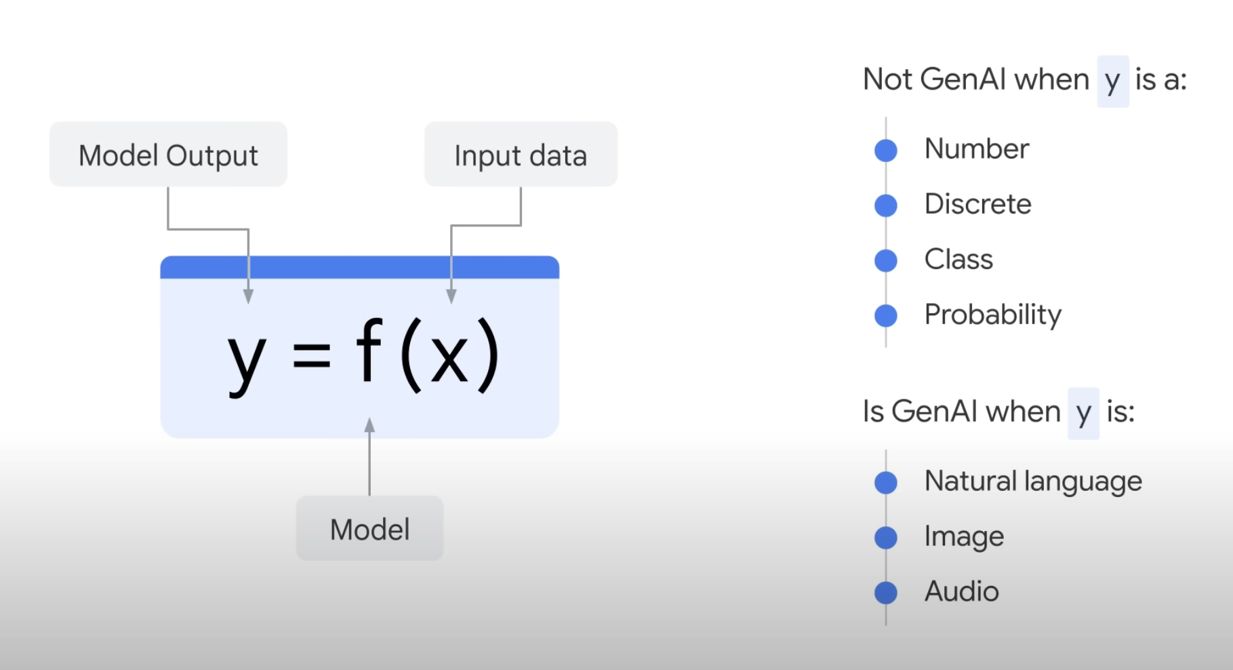
GenAI as represented by mathematics?

Slide 13
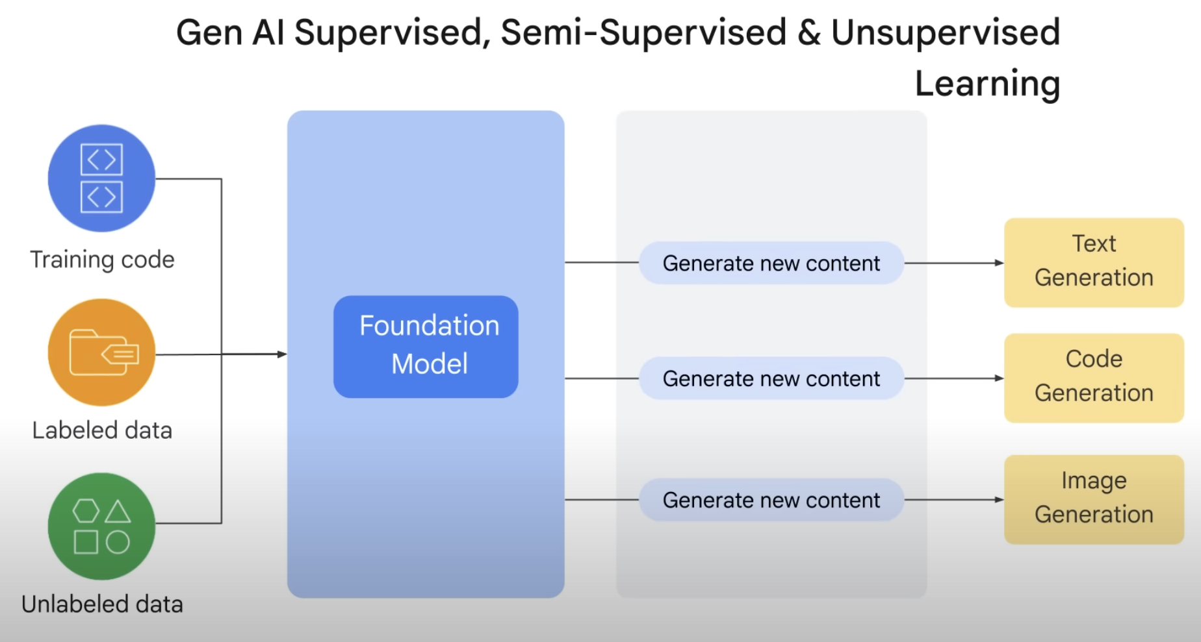
GenAI

Slide 14
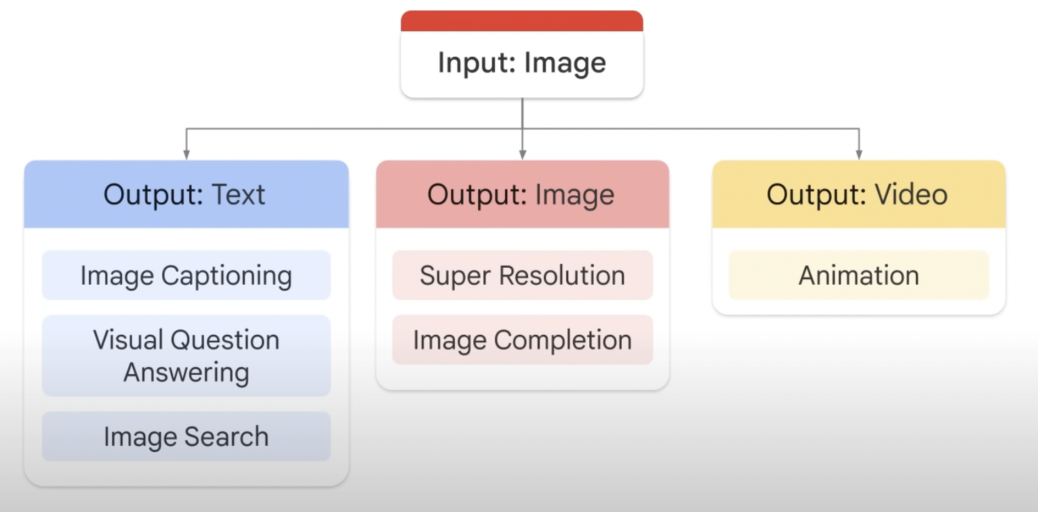
Example of GenAI Input/Output

Slide 15
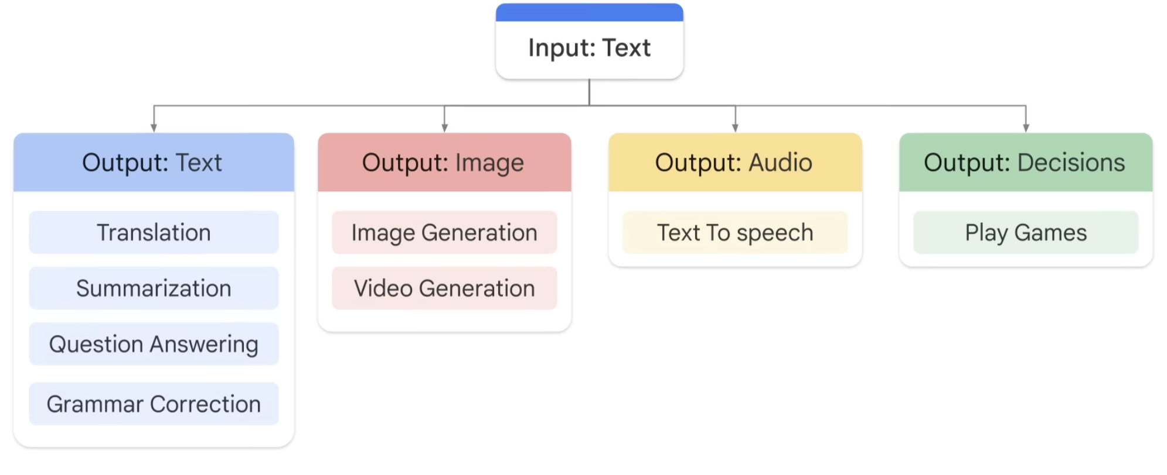
Example of GenAI Input/Output

Slide 16
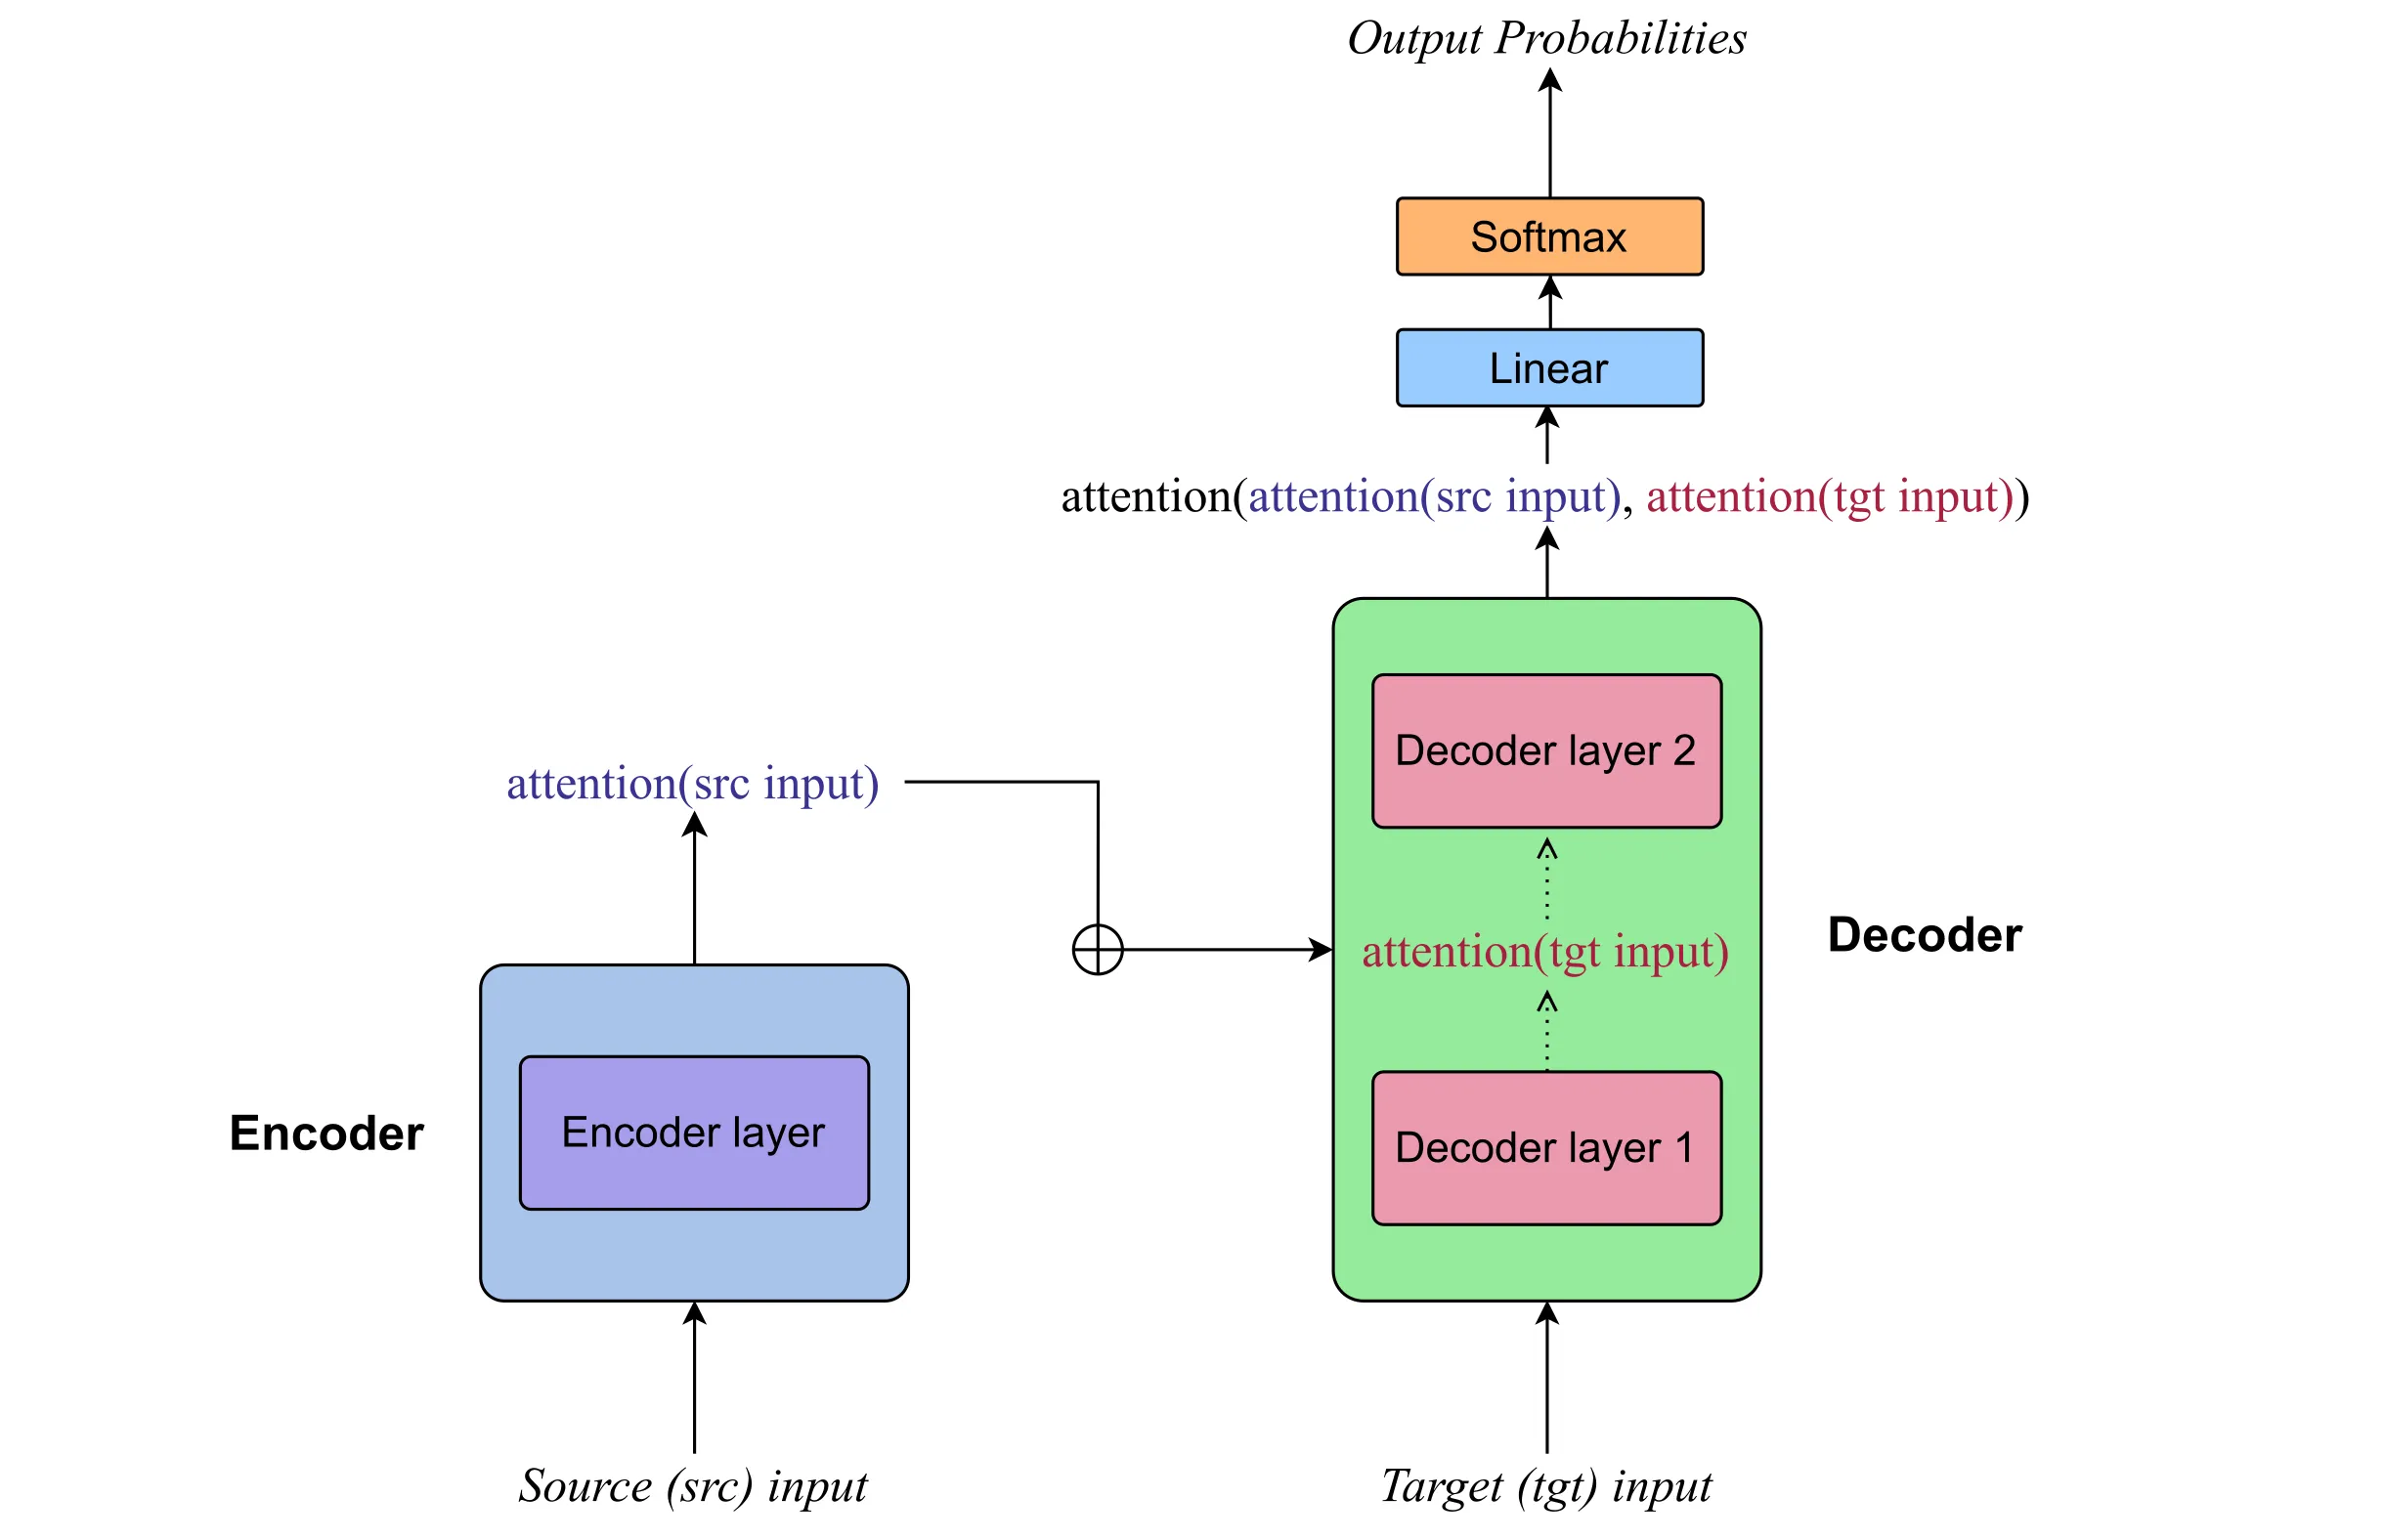
Core component of GenAI: Encoder-Decoder

Slide 17
Encoder
The encoder's role is to process the input sequence (the "Source" in the diagram) and encode it into a fixed-length context vector. This context vector aims to capture the essence of the input sequence's information.
For example, if the input sequence is "I love dogs and cats," the encoder would process each word (or token) in this sentence through layers (like the "Encoder layer" shown in the diagram), which could include LSTM (Long Short-Term Memory) or Transformer layers. Each word is converted into an embedding, and then the sequence of embeddings is processed to create a context vector that represents the entire sequence's meaning.

Slide 18
Decoder
The decoder's role is to generate the output sequence (the "Target" in the diagram) step by step. It uses the context vector provided by the encoder and, during each step, focuses on different parts of the input sequence to decide what the next output should be. This is facilitated by the attention mechanism.
The attention mechanism allows the model to automatically learn to focus on different parts of the input sequence when predicting each word of the output sequence. For example, when translating "I love dogs and cats" into another language, the attention mechanism helps the model to focus on "I love" when it's translating the equivalent words in the target language, and then focus on "dogs" and "cats" for their respective translations.
The decoder layers (like "Decoder layer 1" and "Decoder layer 2" in the diagram) produce a sequence of vectors. Each vector is transformed by a linear layer (fully connected layer) and then passed through a softmax function to predict the probability of each word in the target language's vocabulary. The word with the highest probability is chosen as the next word in the output sequence.

Slide 19
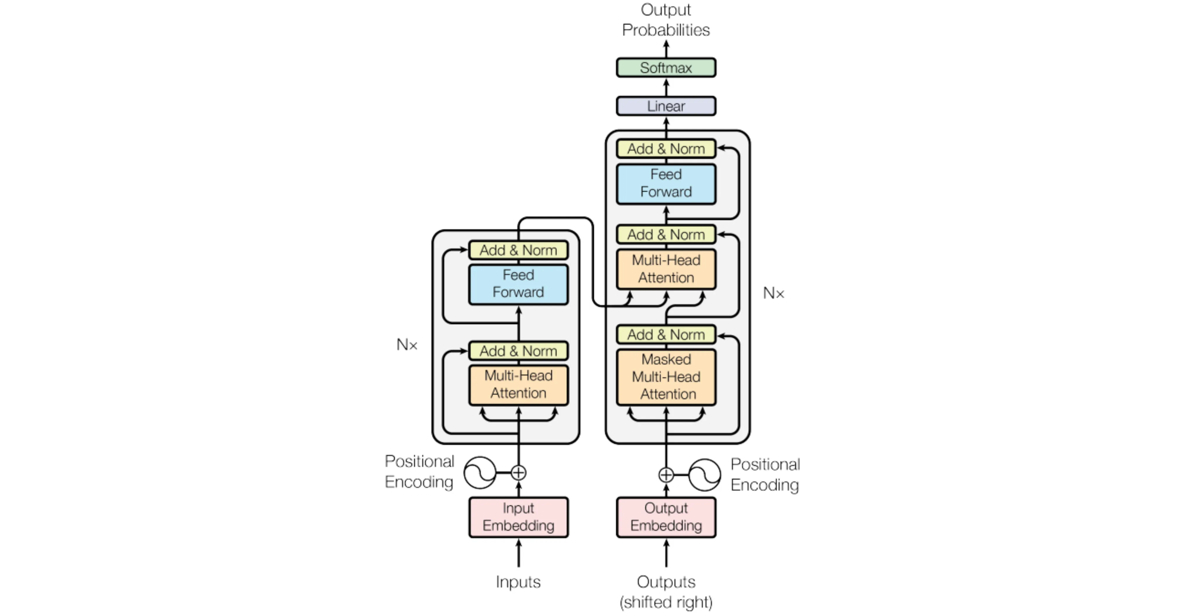
Simple Transformer Model
“Attention Is All You Need”
Encoder
Decoder
Image of the transformer - model architecture from the paper Vaswani, Ashish, et al. 2017

Slide 20
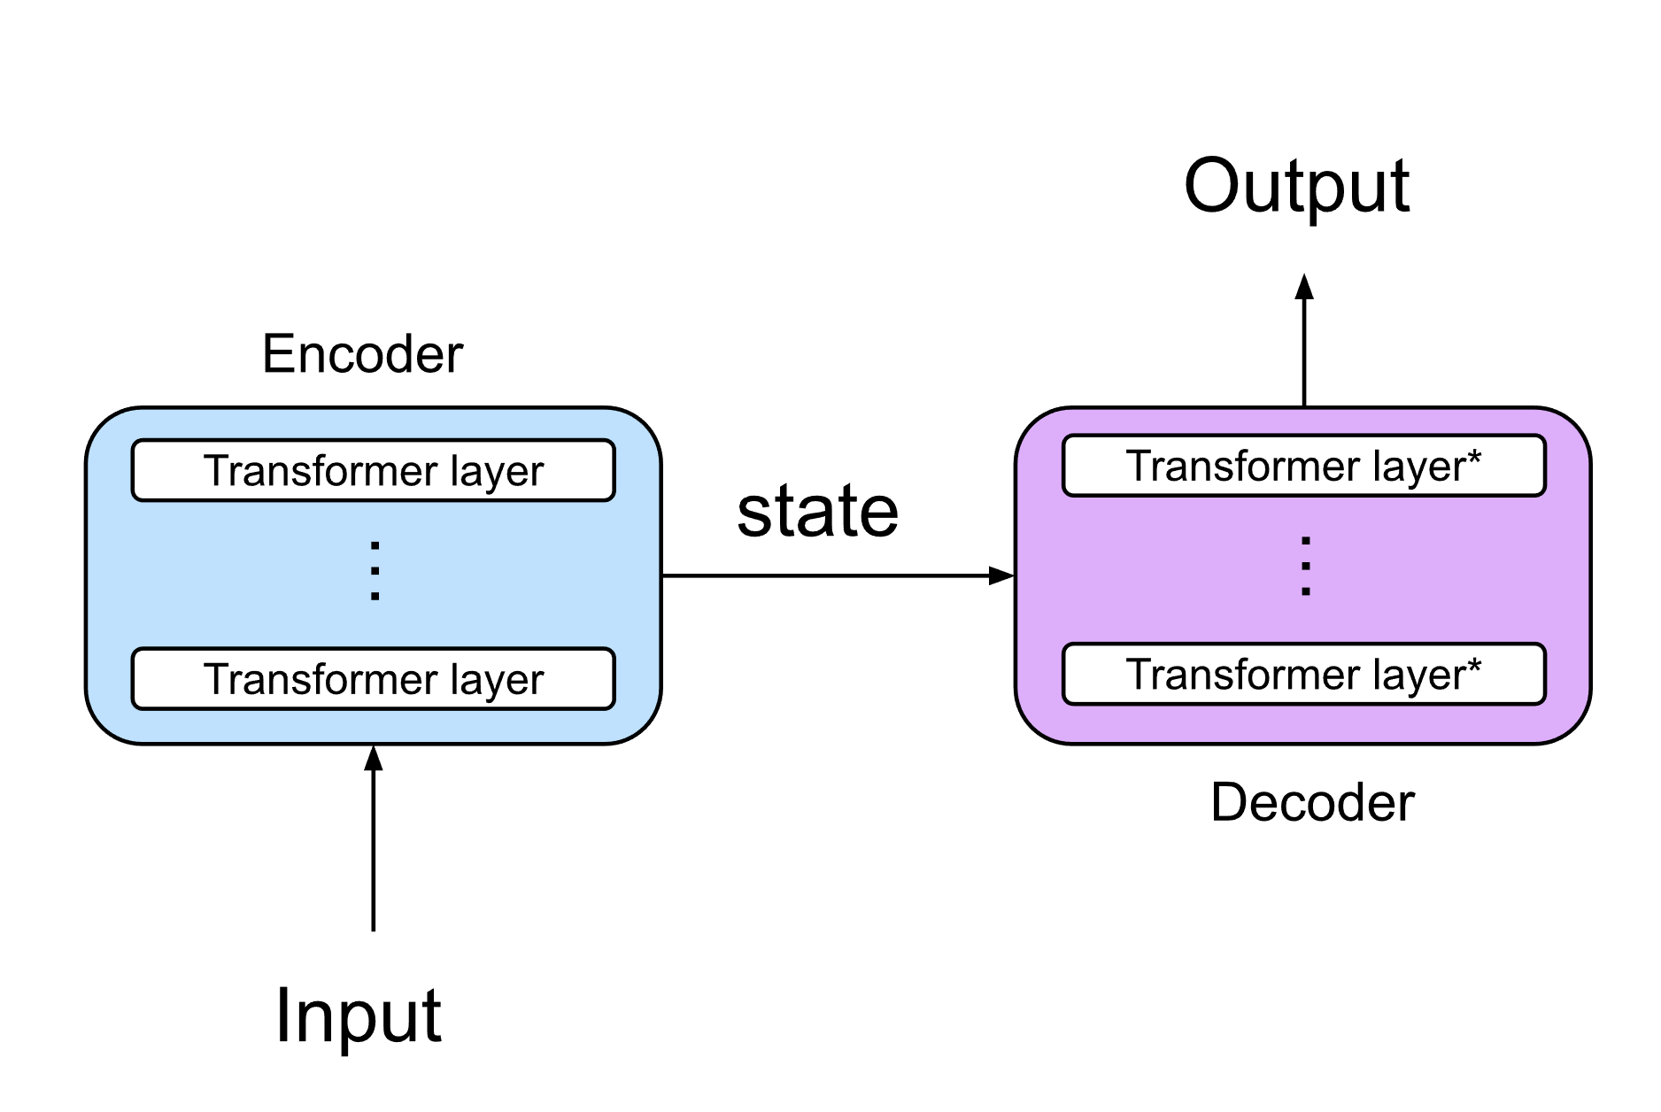
Large Language Model (LLM)
In LLM architecture using Encoder-Decoder, the input sequence is first encoded into a state vector, which is then used to decode the output sequence

Slide 21
A simple LLM in practice
Access the Google Colab notebook: https://colab.research.google.com/drive/1wK33DrTXOt1prS3C_n5DZjA_JVHqVkMu?usp=sharing
For this simple LLM training we will be using the Reuters newswire classification dataset. This dataset contains over 800,000 news articles from the Reuters news agency. The articles are classified into 46 different categories.

Slide 22
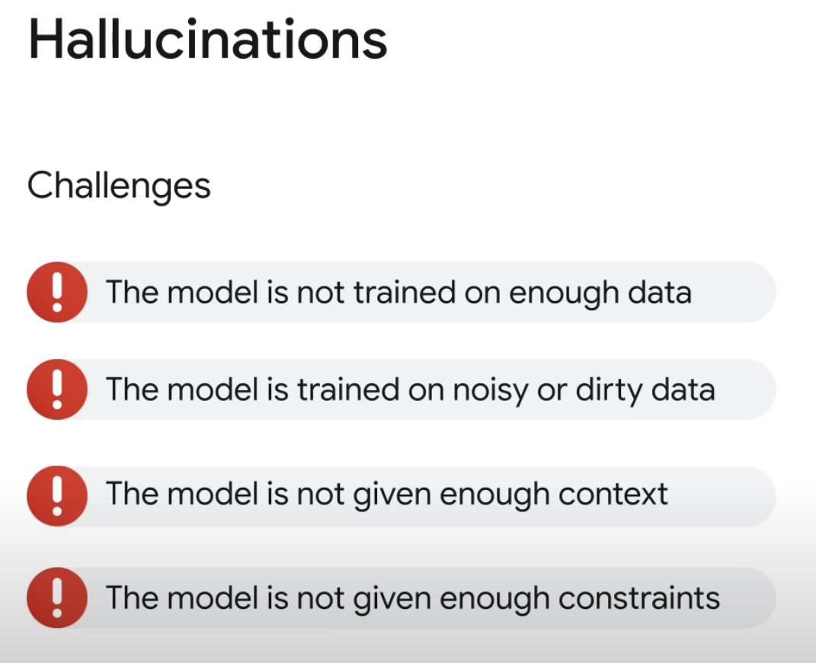
One of the important challenges of GenAI

Slide 23
In-Class Reading & Discussion Task
Read the article ‘Which Ethical Implications Of Generative AI Should Companies Focus On?’, published in Forbes, to understand the ethical implications of Generative AI in practice.
Article link: Which Ethical Implications Of Generative AI Should Companies Focus On?
In a group of 3-5, discuss the top 3 ethical implications that you could identify from the article.

Slide 24
reference
Foster, D. 2019. Generative Deep Learning: Teaching Machines to Paint, Write, Compose, and Play. [Online]. Available at: https://www.oreilly.com/library/view/generative-deep-learning/9781492041931/
Du, N. 2024. Illustrated Guide to Generative AI. [Online]. Available at: https://www.manning.com/books/illustrated-guide-to-generative-ai
Chan, C.K.Y. & Colloton, T. 2024. Generative AI in Higher Education: The ChatGPT Effect. [Online]. Available at: https://doi.org/10.4324/9781003459026
Lahby, M., Schaeffer, S.E., Maleh, Y. & Paliktzoglou, V. 2026. Generative AI in Higher Education Assessment: Theory, Practice, and Ethical Implications.
Carrigan, M. 2024. Generative AI for Academics.

